Slide 1
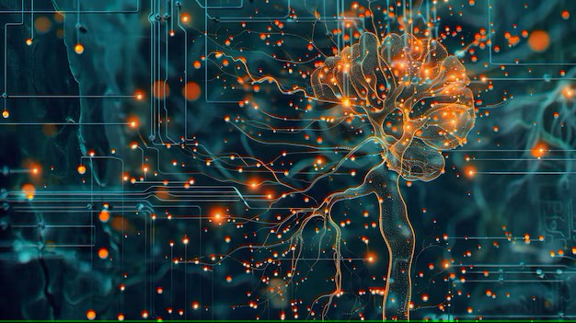


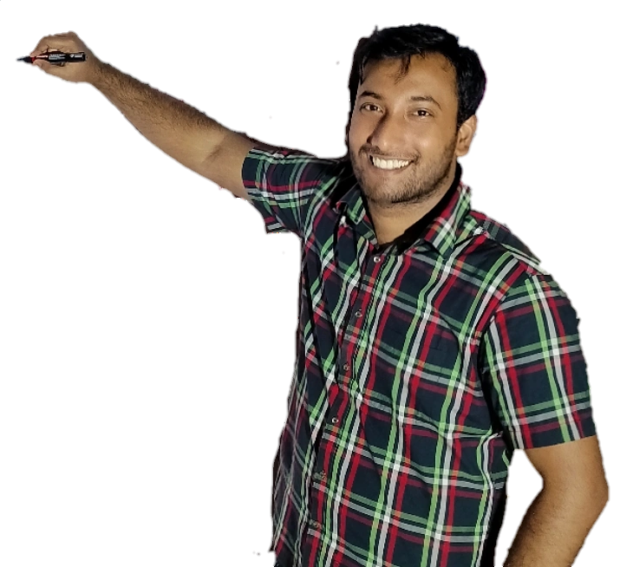
Week-7 (Discussion)
11th Mar, 2025
Deep Learning
Prof. Sudarshan Iyenger
Professor and Head of the Department
Department of Computer Science and Engineering
IIT Ropar
Ayan Paul
PMRF Research Scholar
IIT Kharagpur

Slide 2
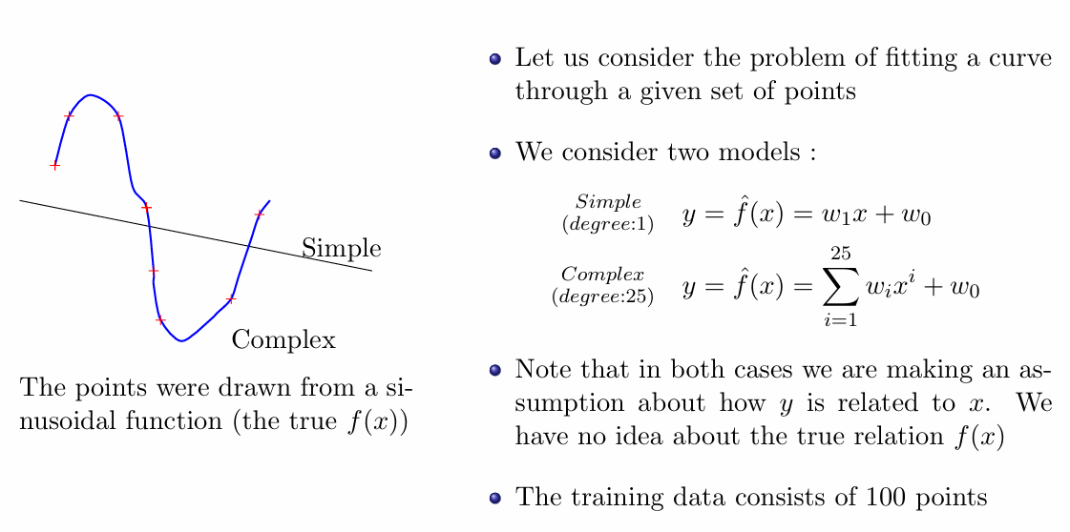
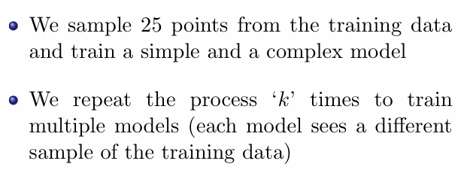
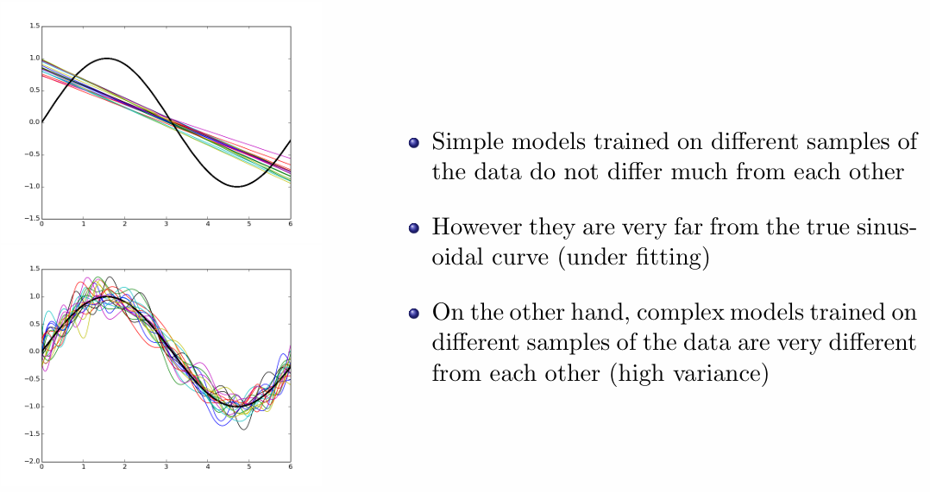
Simple vs. Complex Model

Slide 3
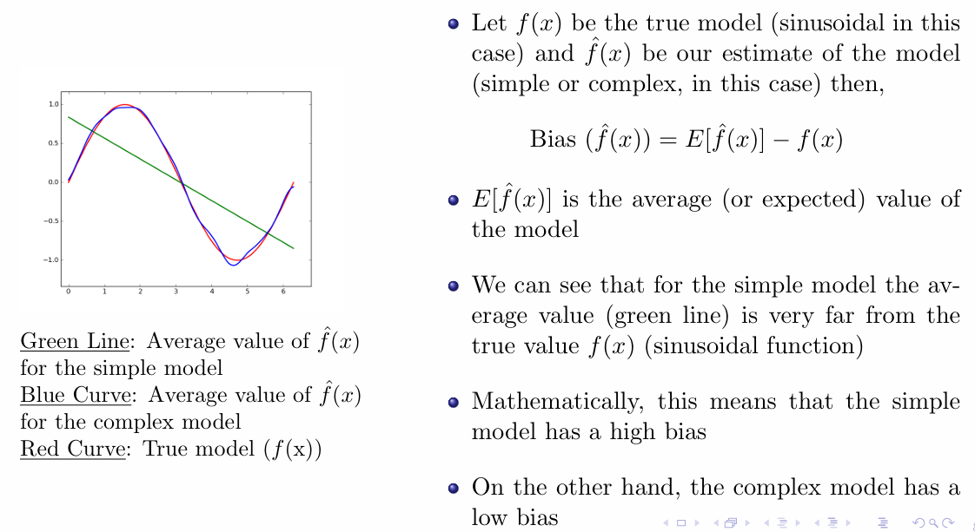
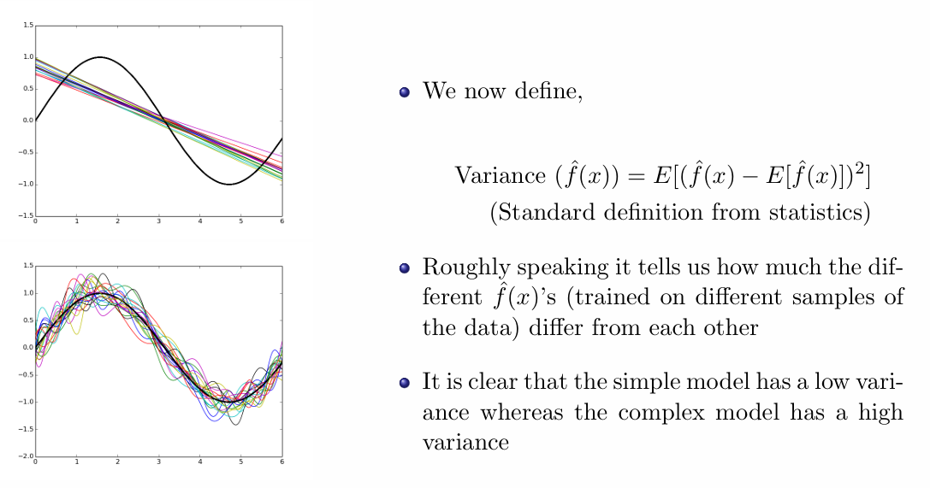
Bias
Variance

Slide 4
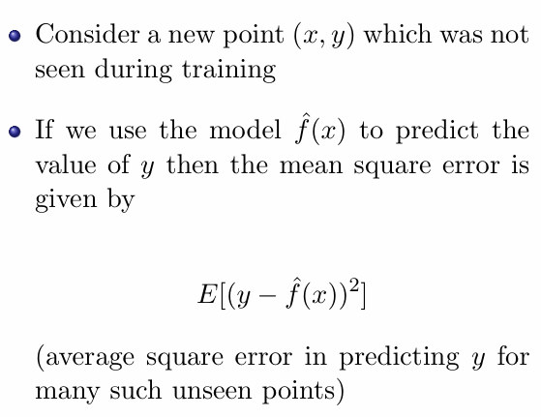
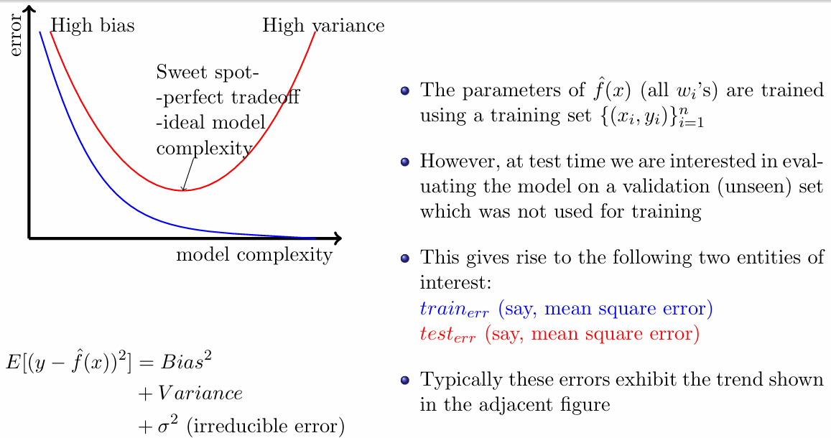
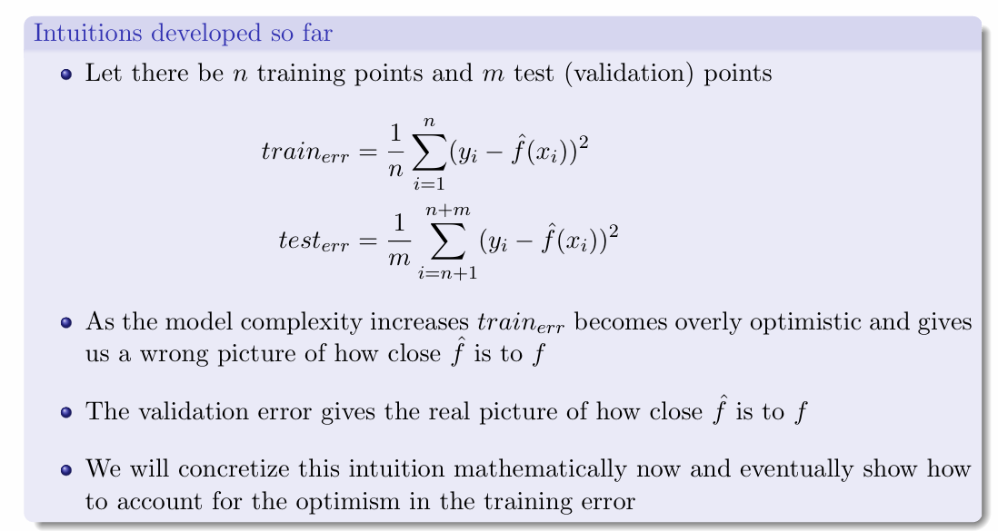
Train vs. Test Error

Slide 5
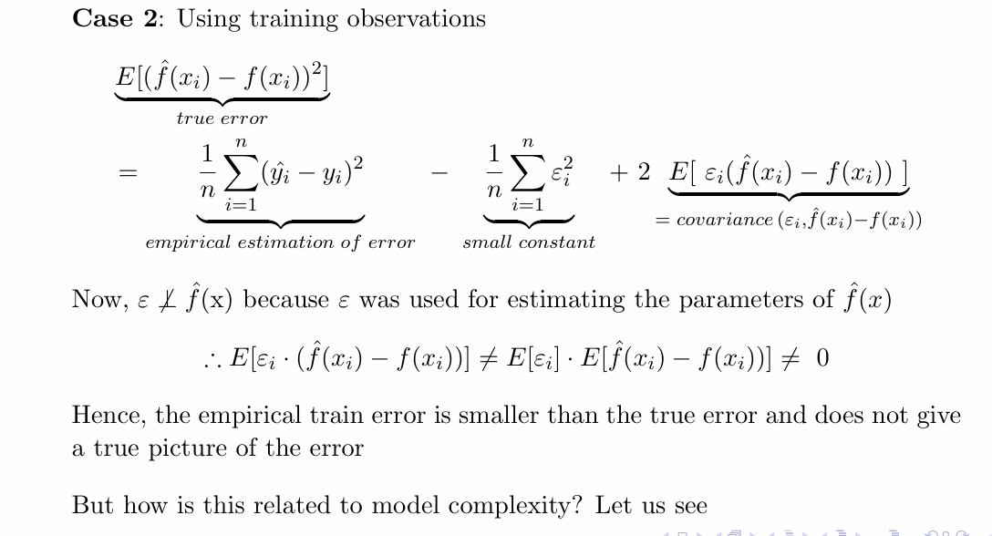
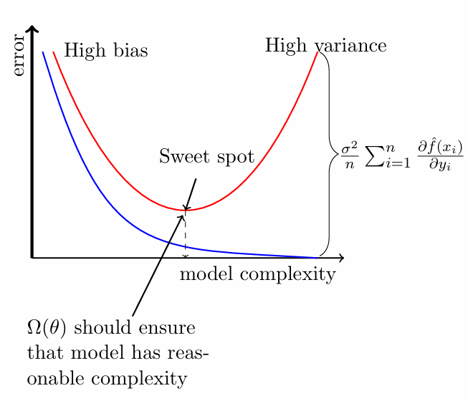
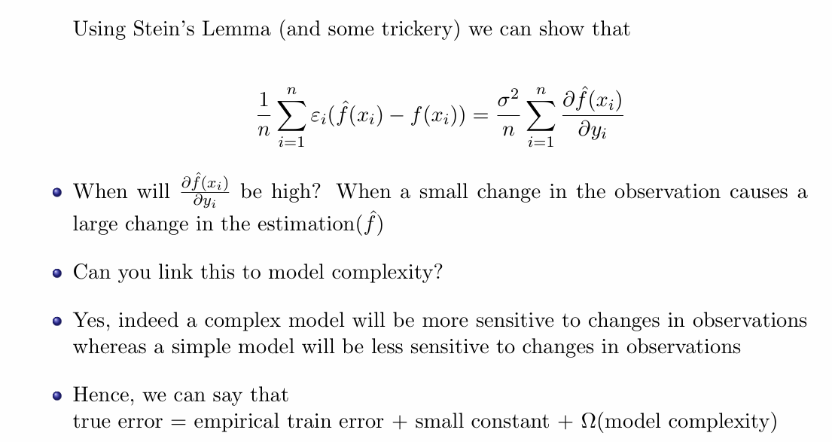
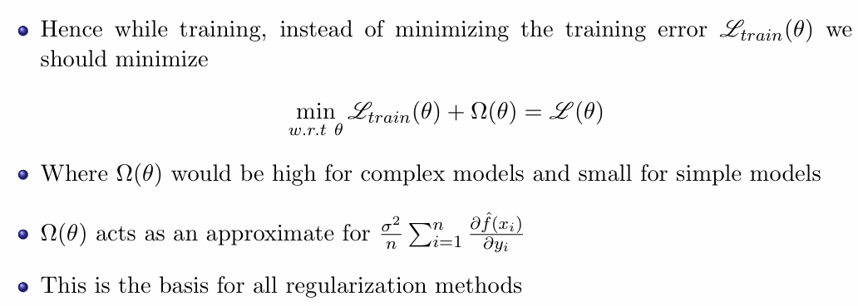
True Error vs. Model Complexity

Slide 6
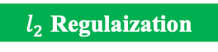
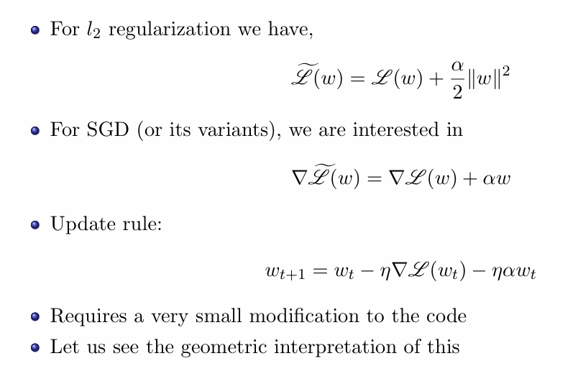
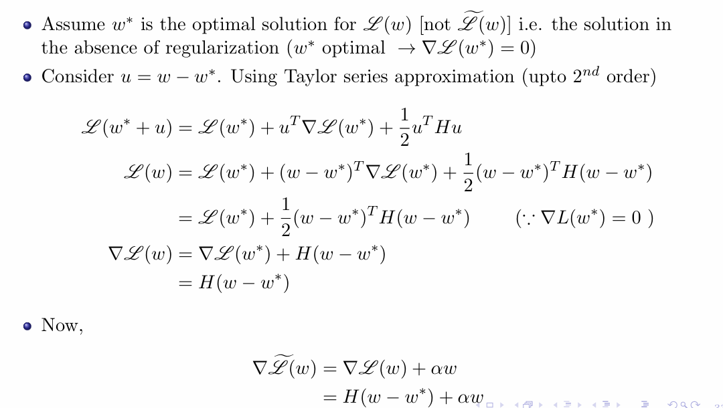
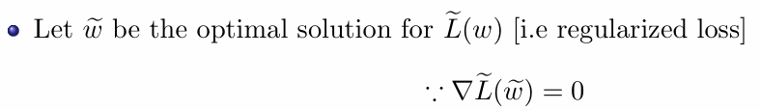
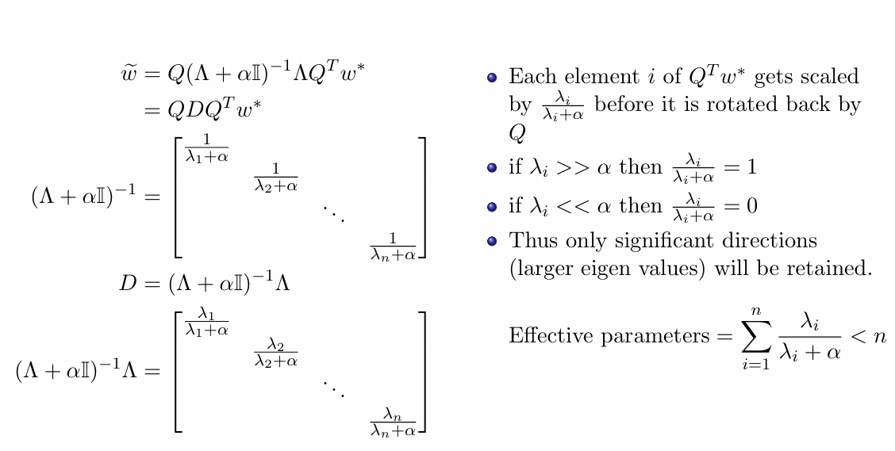
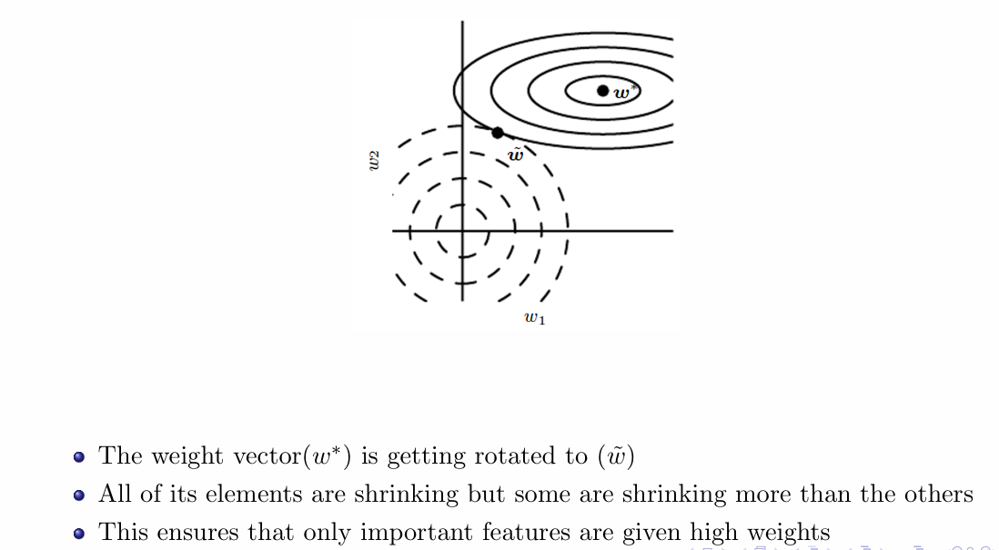
Different Forms of Regularization

Slide 7
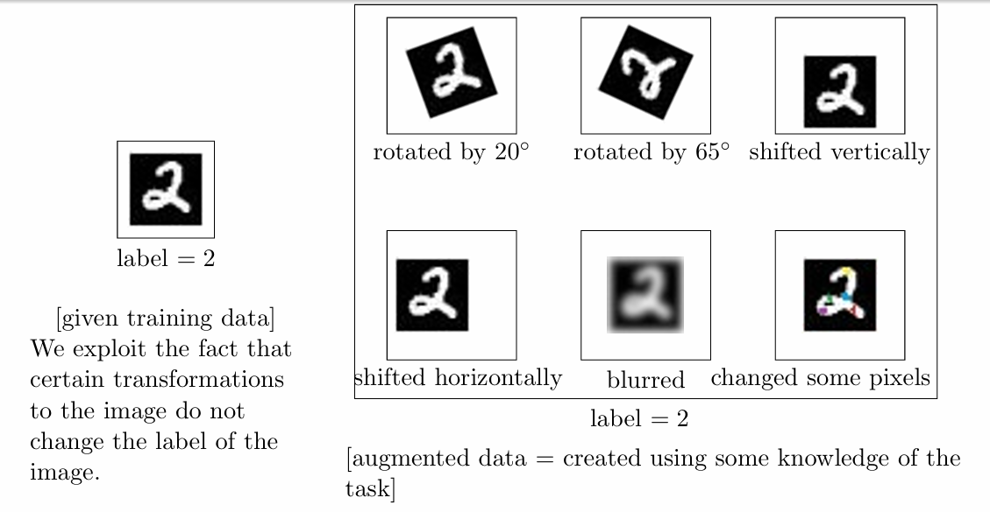
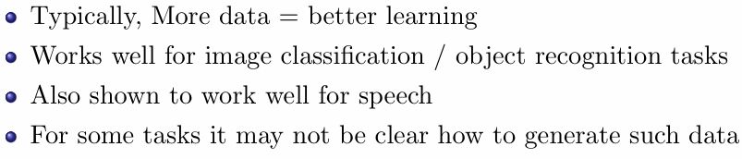
Dataset Augmentation

Slide 8
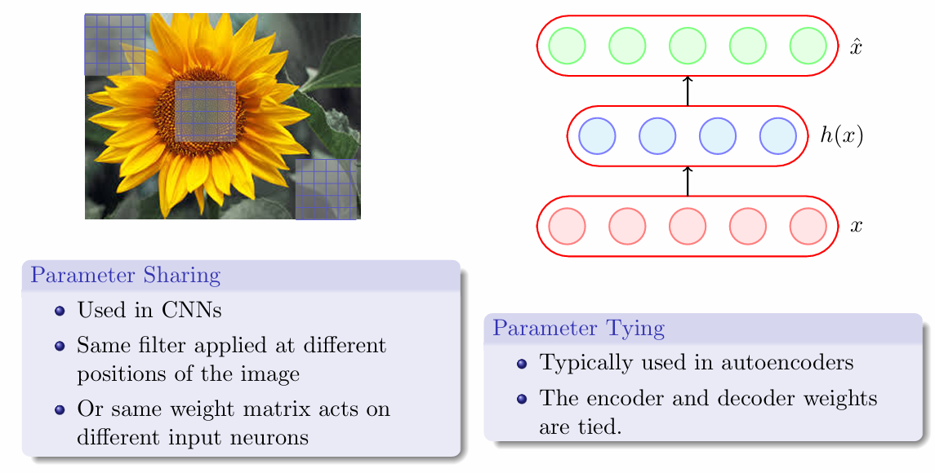
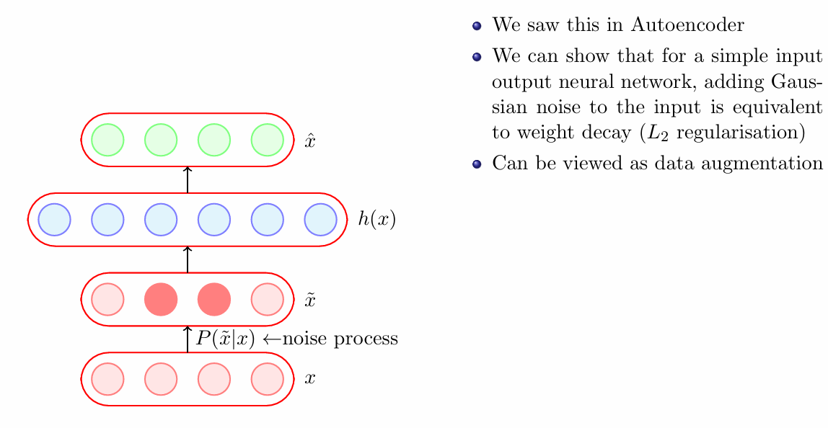
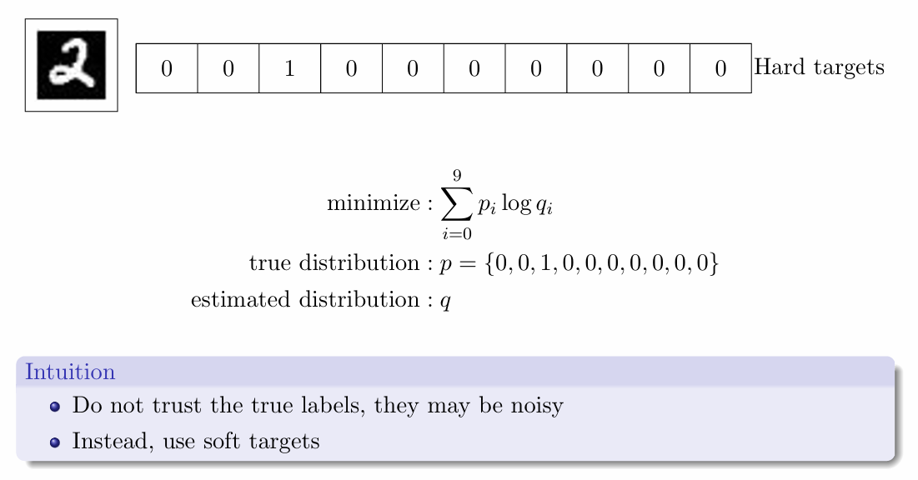
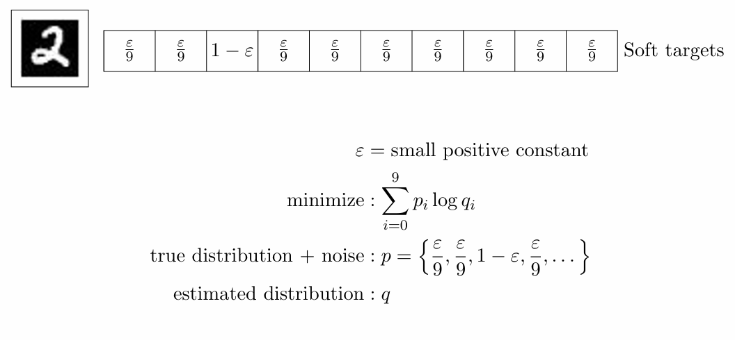
Parameter Sharing and Tying
Adding Noise to Inputs
Adding Noise to Outputs

Slide 9
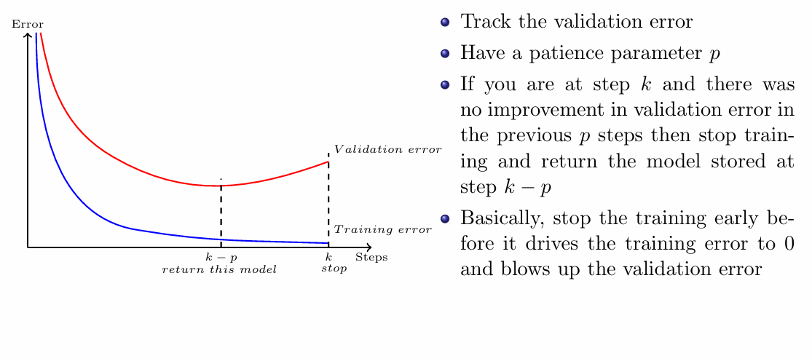
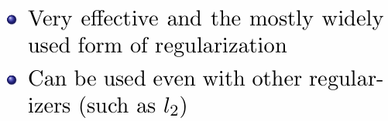
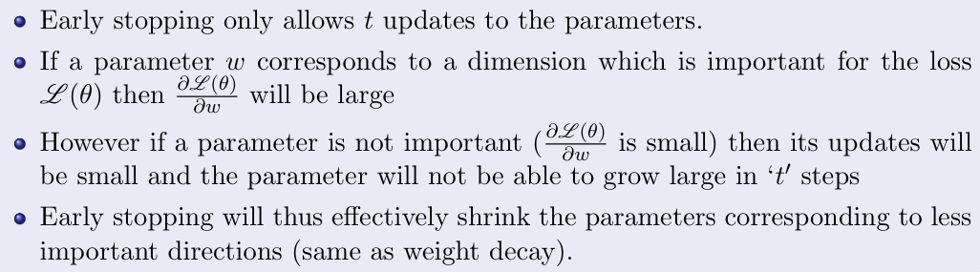
Early Stopping

Slide 10
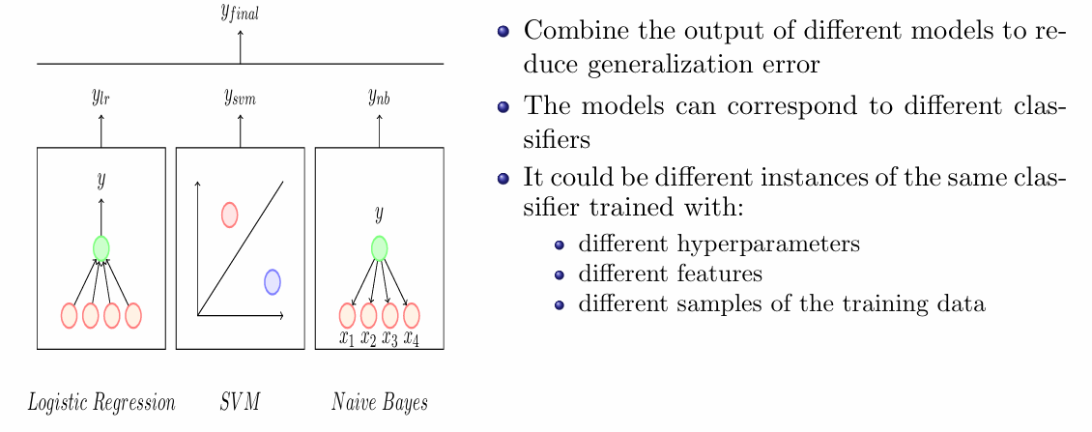
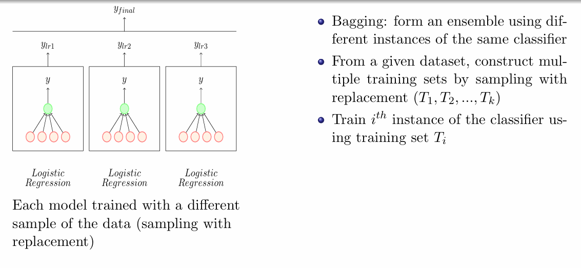
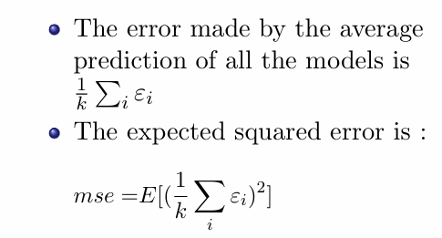
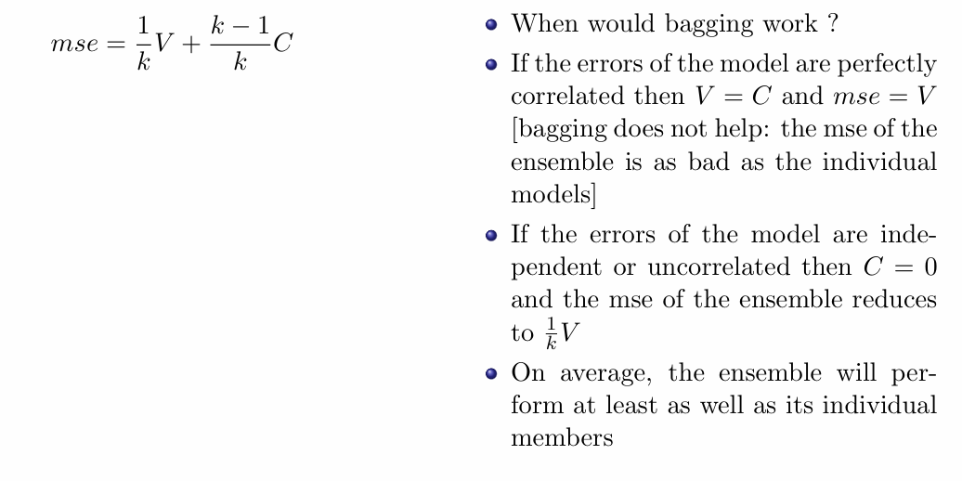
Ensemble Methods

Slide 11
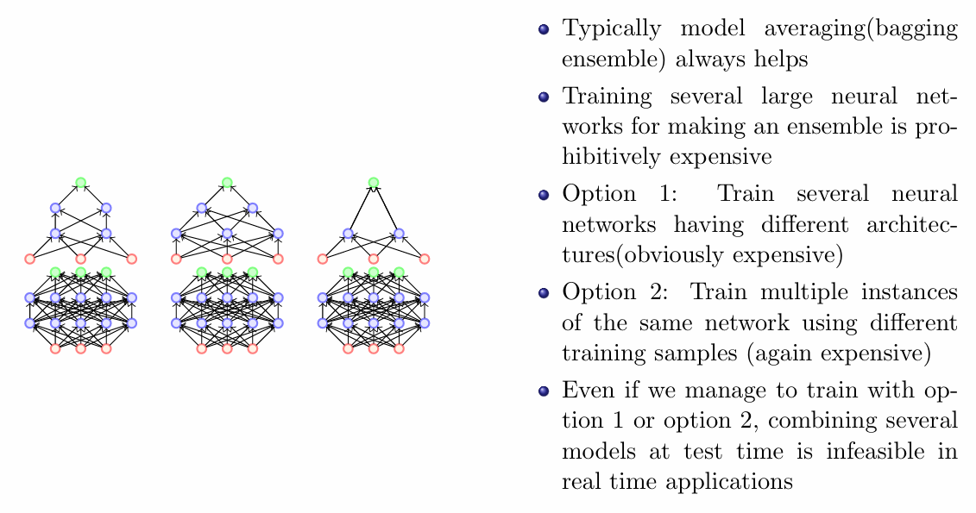
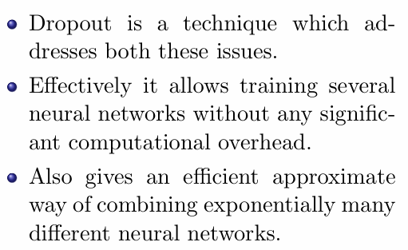
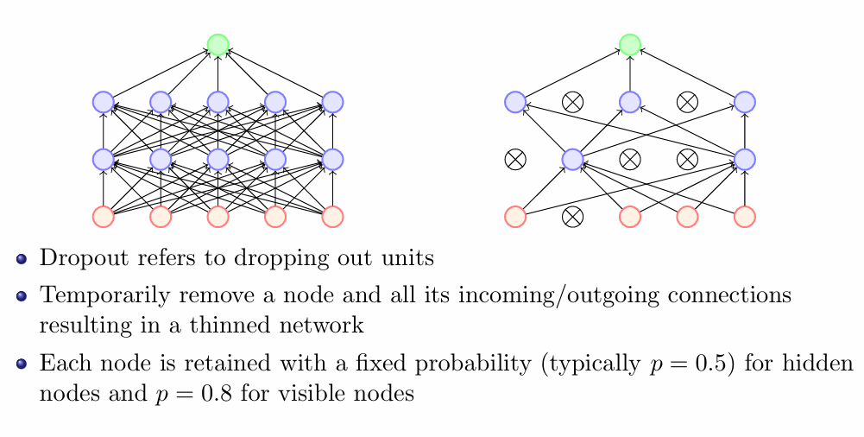
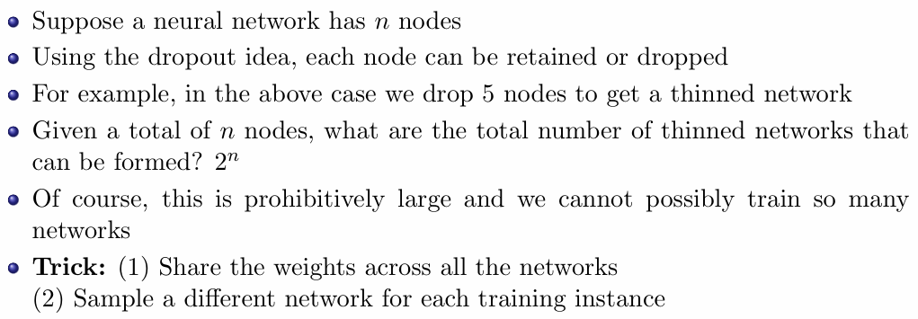
Dropout

Slide 12
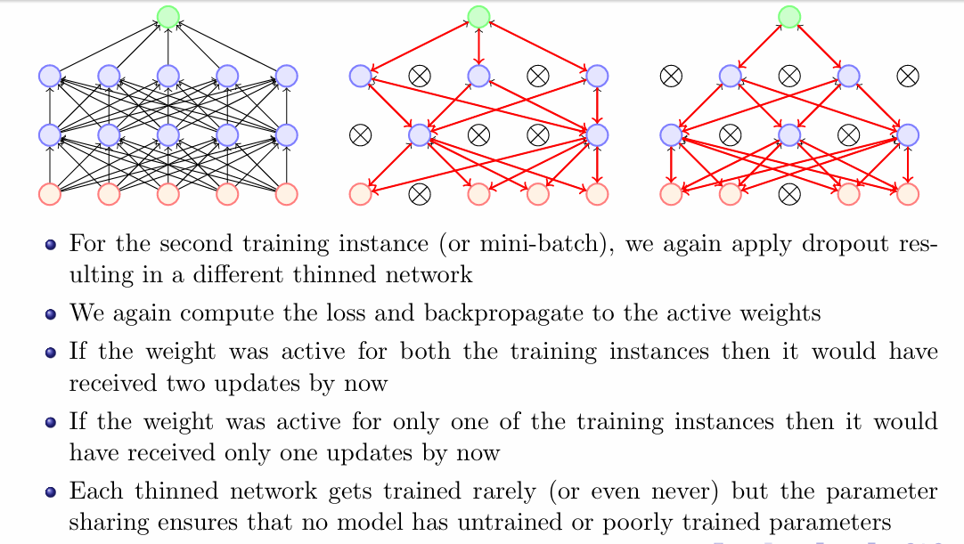
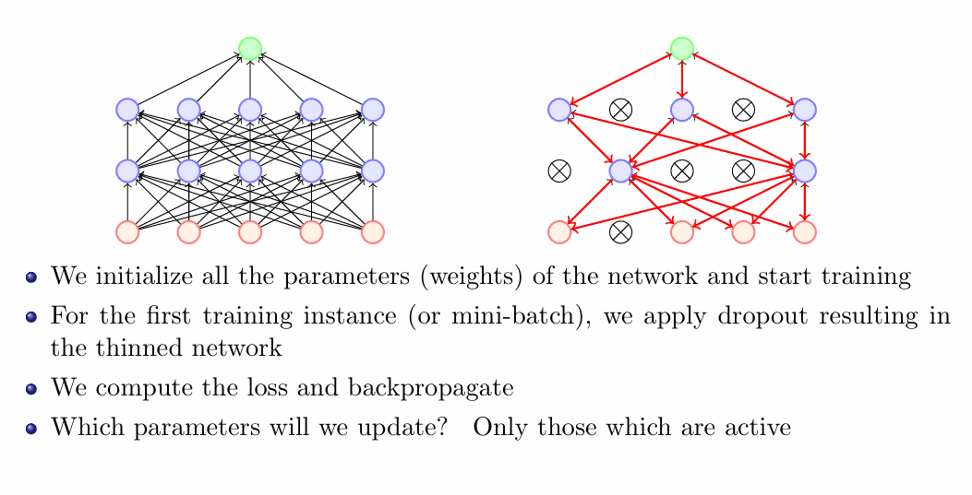
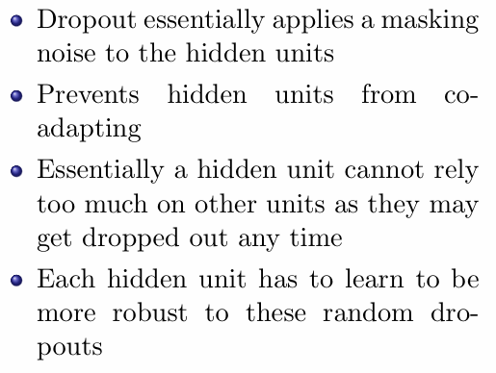
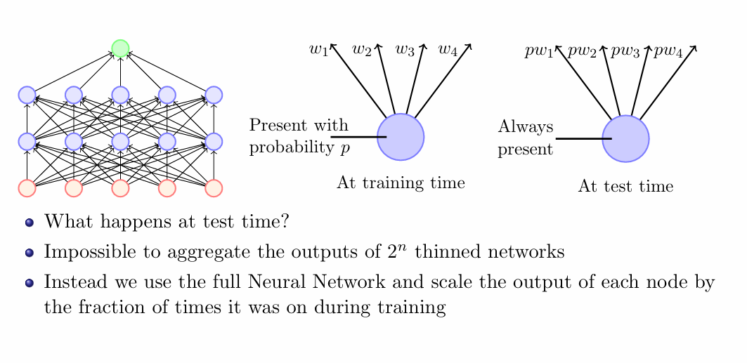

Slide 13
Topics on which Week 7 Assignment Questions are based
Bias and Variance
Train and Test Error
True Error and Model Complexity
Different types of Regularization

Slide 14
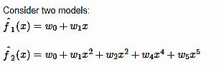
Common Data Q1-Q2

Slide 15
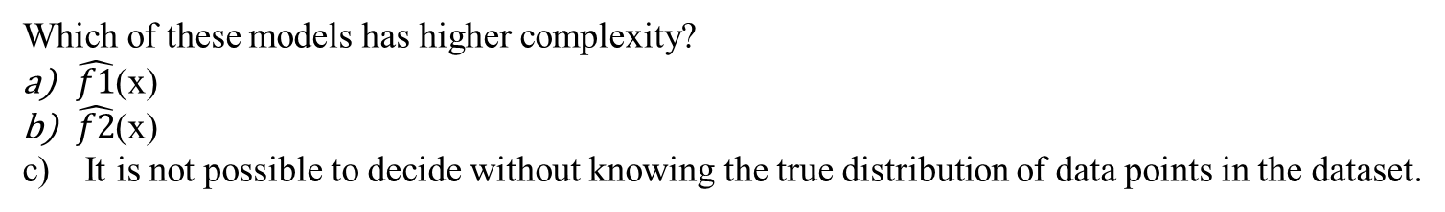
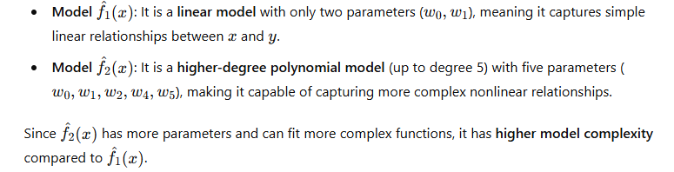
QUESTION 1
SOLUTION 1
CORRECT ANSWER 1
b)

Slide 16
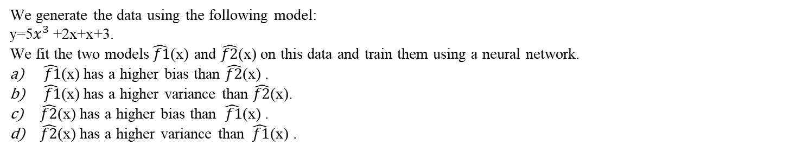
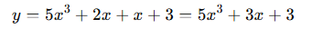
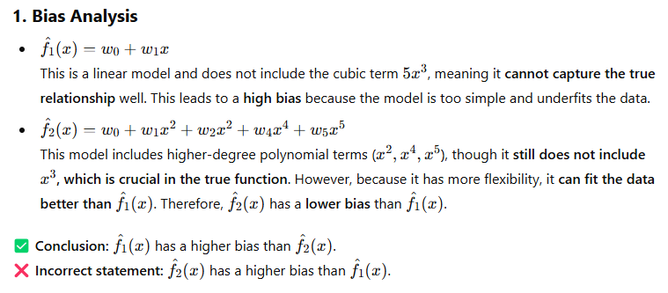
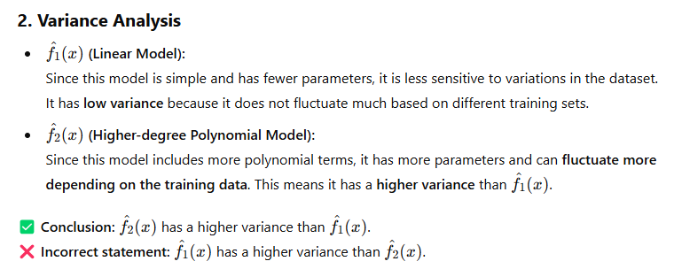
QUESTION 2
SOLUTION 2
CORRECT ANSWER 2
a), d)

Slide 17
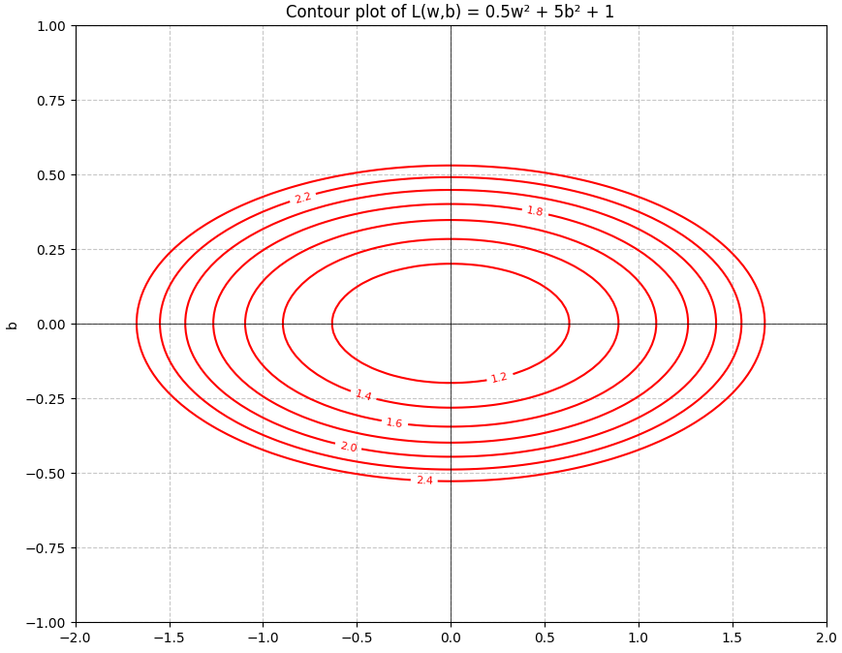
Common Data Q3-Q4
Consider a function and its contour plot given below:

Slide 18
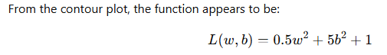


QUESTION 3
What is the sum of the elements of ∇L(w∗,b∗)?
SOLUTION 3
CORRECT ANSWER 3
0

Slide 19



QUESTION 4
According to the eigen-values of the Hessian, which parameter is the loss more sensitive to?
b
w
SOLUTION 4
CORRECT ANSWER 4
a)

Slide 20

QUESTION 5
In Neural Networks, bagging is computationally expensive in terms of
Training
Testing
Both training and testing
None of the above
SOLUTION 5
CORRECT ANSWER 5
c)

Slide 21



QUESTION 6
We are training a neural network with following patience parameter = 2. When will the training stop?
After epoch 5
After epoch 4
After epoch 6
After epoch 3
SOLUTION 6
CORRECT ANSWER 6
a)

Slide 22


QUESTION 7
Suppose that a model produces zero training error. What happens if we use L2 regularization, in general?
It might increase training error
It might decrease test error
It might decrease training error
Reduce the complexity of the model by driving less important weights to close to zero
SOLUTION 7
CORRECT ANSWER 7
a), b), d)

Slide 23



QUESTION 8
SOLUTION 8
CORRECT ANSWER 8
a), c)

Slide 24



QUESTION 9
We have trained four different models on the same dataset using various hyperparameters. The training and validation errors for each model are provided below. Based on this information, which model is likely to perform best on the test dataset?
Model 1
Model 2
Model 3
Model 4
SOLUTION 9
CORRECT ANSWER 9
b)

Slide 25


QUESTION 10
Consider the problem of recognizing an alphabet (in upper case or lower case) of English language in an image. There are 26 alphabets in the language. Therefore, a team decided to use CNN network to solve this problem. Suppose that data augmentation technique is being used for regularization. Then which of the following transformation(s) on all the training images is (are) appropriate to the problem
Rotating the images by ±10̊
Rotating the images by ±180̊
Translating image by 1 pixel in all direction
Cropping
SOLUTION 10
CORRECT ANSWER 10
a), c), d)

